Slide 1
Support Services Summer 2014 Update
August 14, 2014

Slide 2

Support Services Departments
Building Services
Transportation
Fiscal Services
Child Nutrition

Slide 3

Department Overview
Maintenance
Custodial
Environmental Management
The Department is responsible for the School Division's 27 schools and two service facilities. That is over 2.3 million square feet and 631 acres.
Capital
Improvement Program

Slide 4
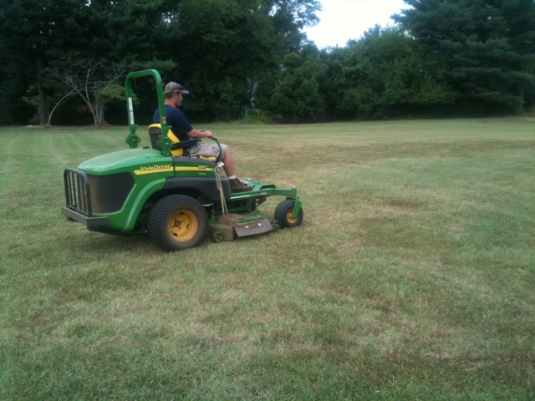
Maintenance
Over 40 employees of the Buildings & Grounds Department worked on various tasks including:
  Mowing/grounds
  Moving furniture
  Assisting contractors
  Carpentry work
  Electrical work
  Mechanical work
  Plumbing work

Slide 5
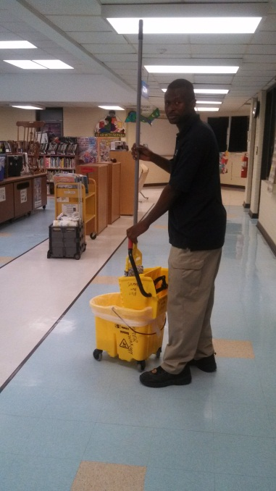
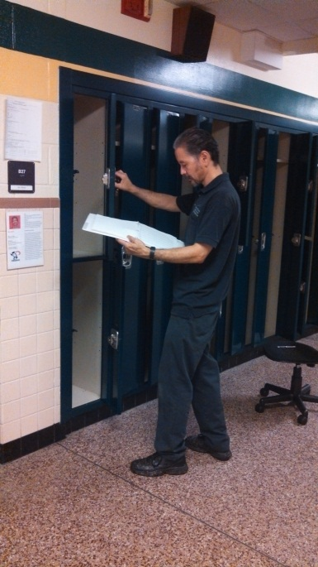
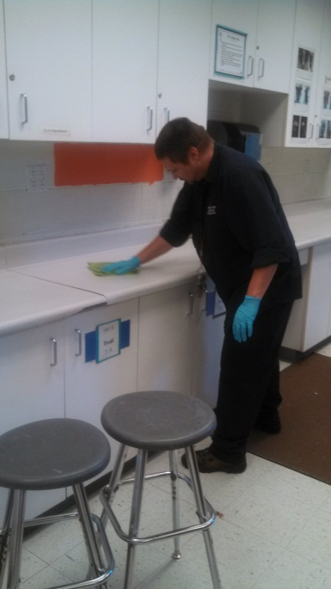
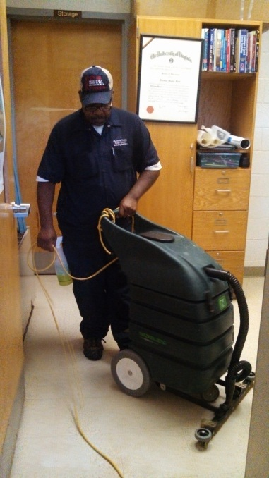
Custodial Work
Over 140 Employees
Detailed cleaning of ALL schools, ceiling to floor.
Floor refinishing
Provide services for numerous summer programs, camps, and community building rentals.

Slide 6
Special Projects

Slide 7

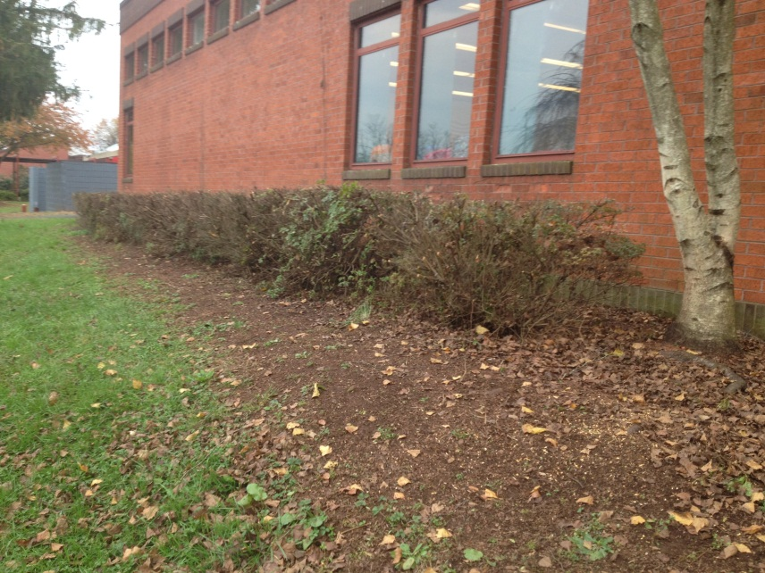
Security Improvements
Began pilot program of classroom door hardware upgrades to improve efficiency of securing a classroom during a lock down
Completed tree trimming and landscaping to improve visibility based on CEPTED recommendations.

Slide 8
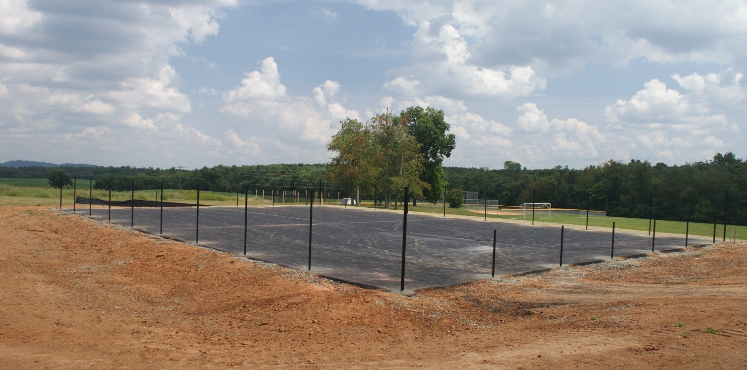
QuickStart Tennis Court Donation
Crozet Elementary

Slide 9
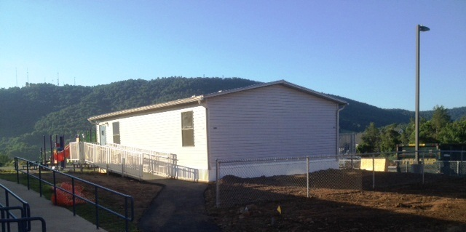
Mobile Classroom Relocation
Mobile classrooms were moved from Hollymead to Greer & Cale due to enrollment growth.

Slide 10
Summer Rentals
CFA @ Monticello HS
YMCA & Sports Camps
Parks & Recreation
Church Groups
Other

Slide 11
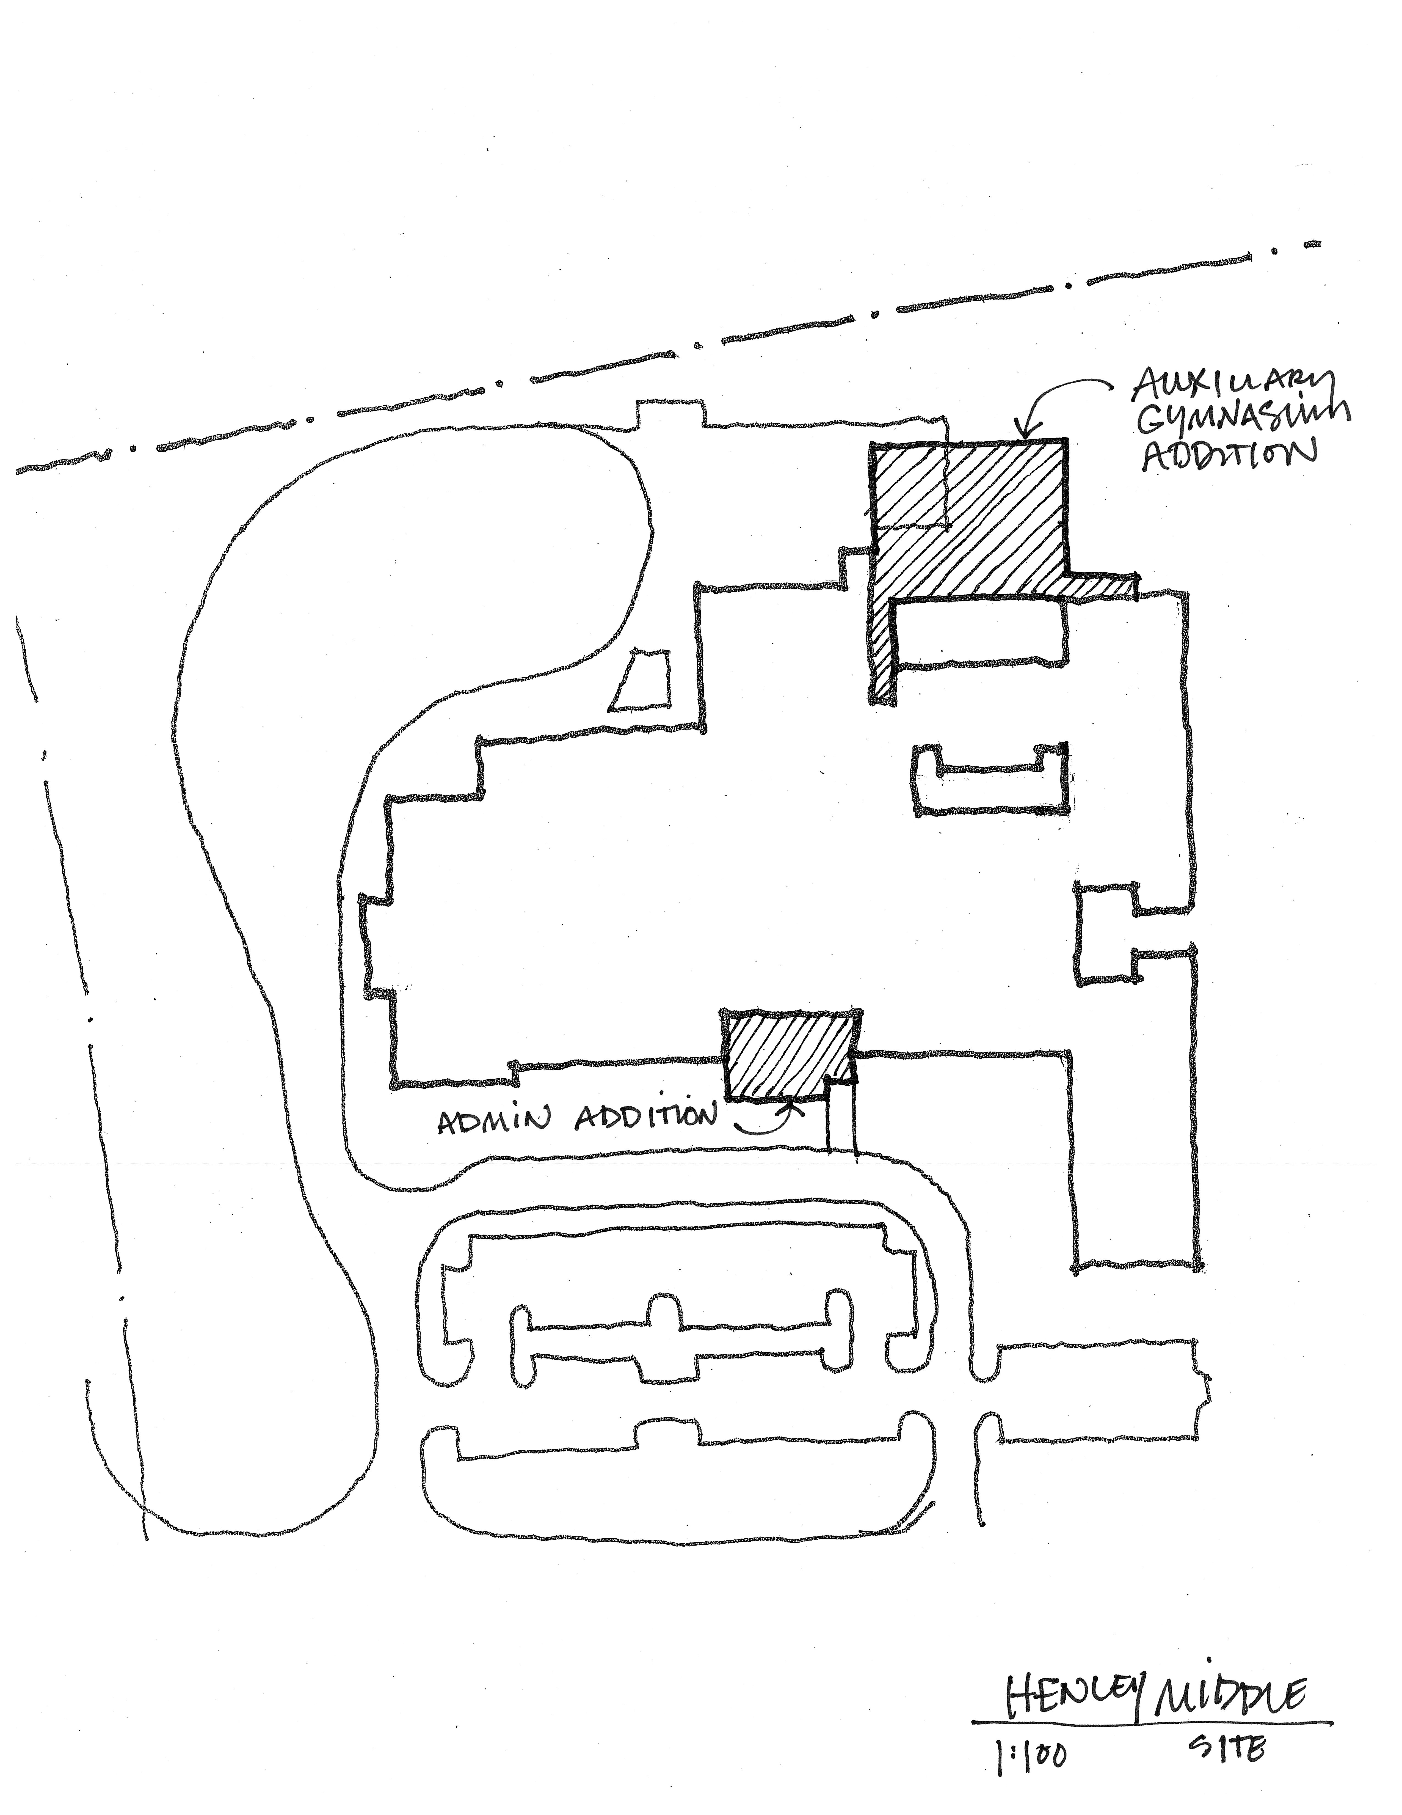
Design: Henley Gym Addition
Design began in July & scheduled to be completed by December
BCWH Architects & design committee has met 4 times
Addition will open during the winter of the 2015/16 school year

Slide 12
Capital Projects
LARGE
ROOF
HVAC
SITE
BUILDING

Slide 13
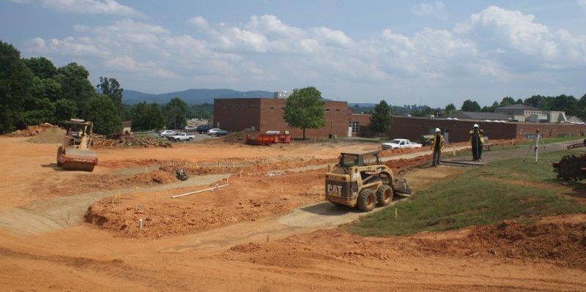
Agnor-Hurt Addition
Capital Projects: LARGE ROOF HVAC SITE BUILDING

Slide 14
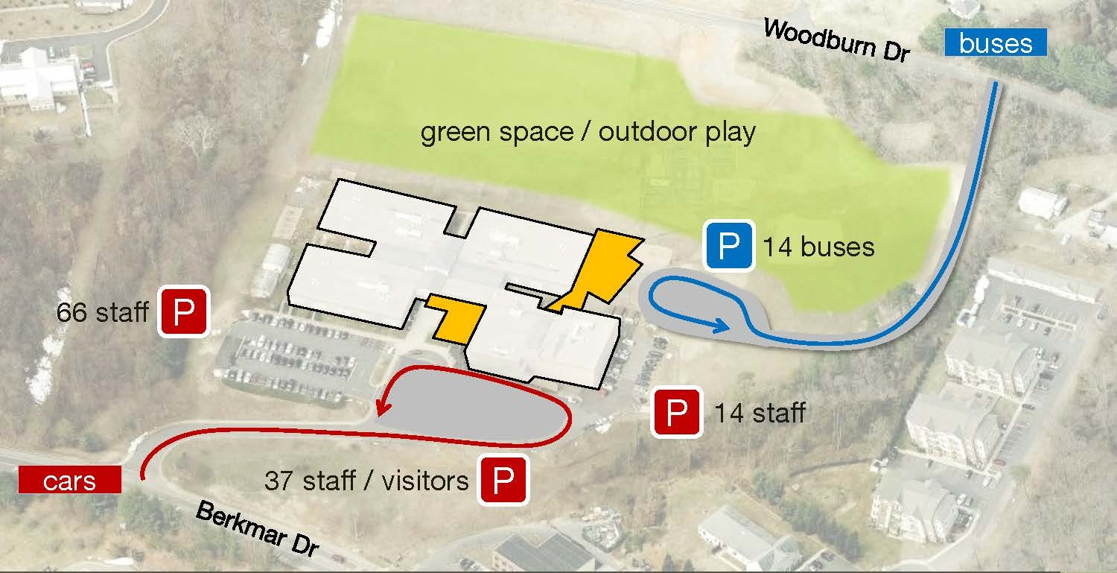
Agnor-Hurt Addition
Capital Projects: LARGE ROOF HVAC SITE BUILDING
Completion: Summer 2015

Slide 15
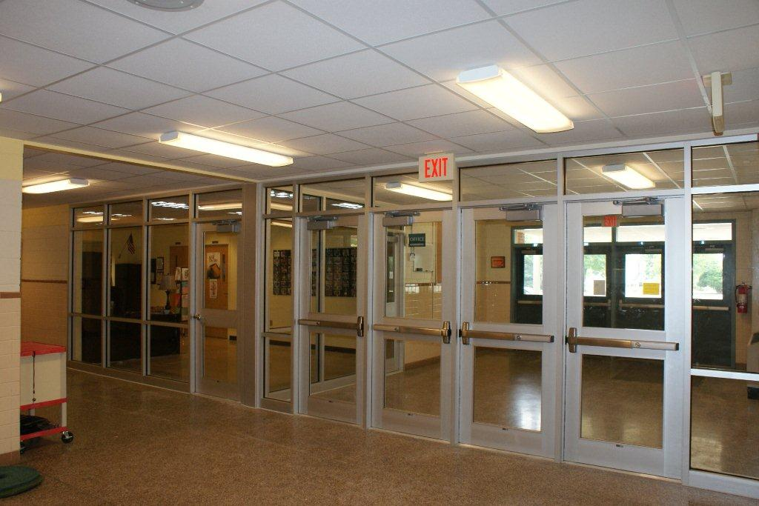
Front Entrance Security Improvements
Capital Projects: LARGE ROOF HVAC SITE BUILDING
Work completed at:
Broadus Wood
Brownsville
Burley
Crozet
Meriwether Lewis
Monticello
Murray ES
Stone Robinson
Stony Point
Sutherland
Walton
Woodbrook
Yancey

Slide 16
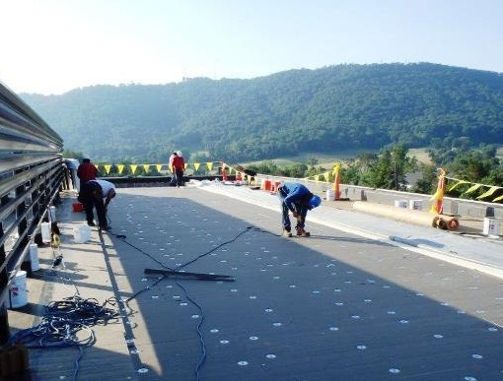
Roof Replacements
Capital Projects: LARGE ROOF HVAC SITE BUILDING
Work completed at:
Cale (Phase 2 of 2)
Stone Robinson
Yancey

Slide 17
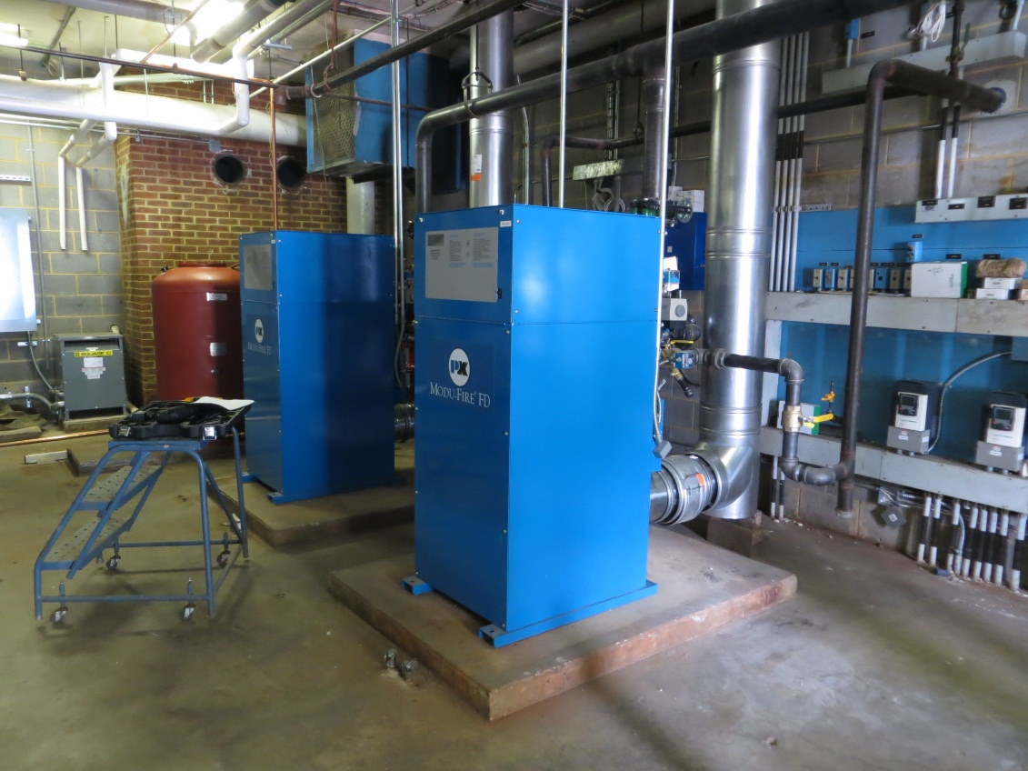
Boiler Replacements
Capital Projects: LARGE ROOF HVAC SITE BUILDING
Work completed at:
Burley
Cale
Hollymead

Slide 18
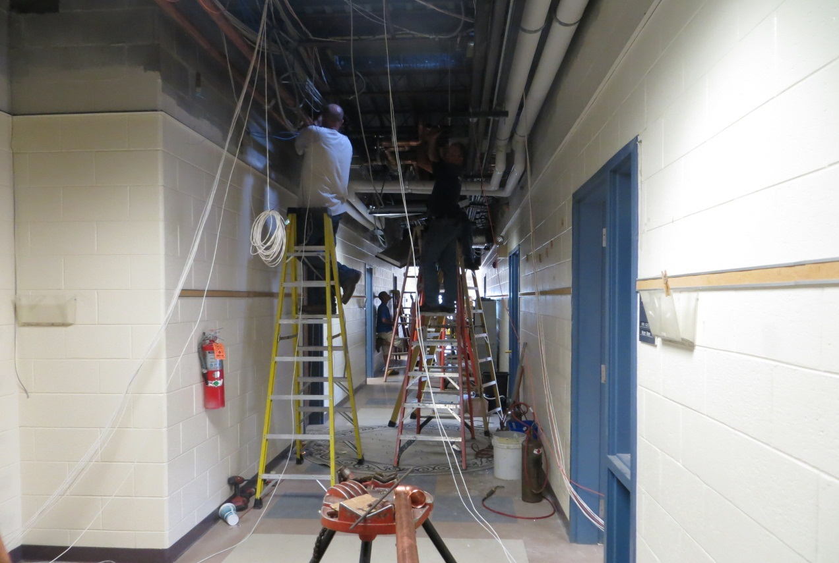
Stone Robinson HVAC Upgrades
Capital Projects: LARGE ROOF HVAC SITE BUILDING

Slide 19
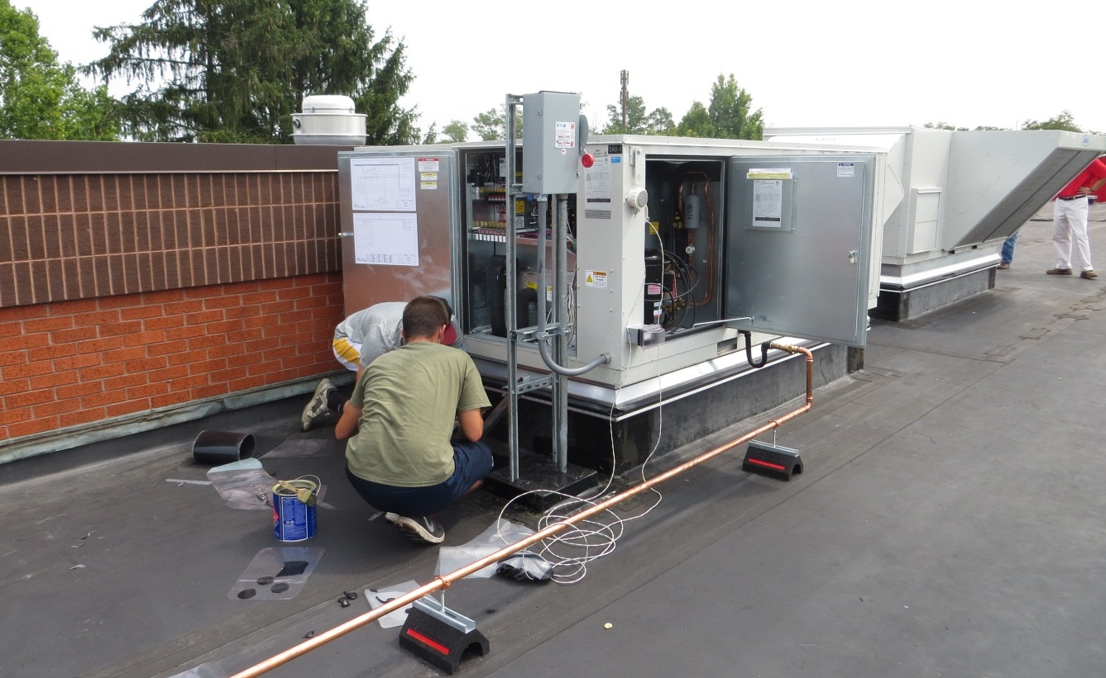
Scottsville HVAC Upgrades
Capital Projects: LARGE ROOF HVAC SITE BUILDING

Slide 20
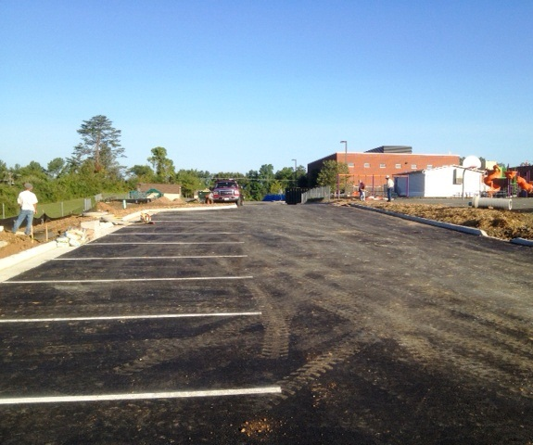
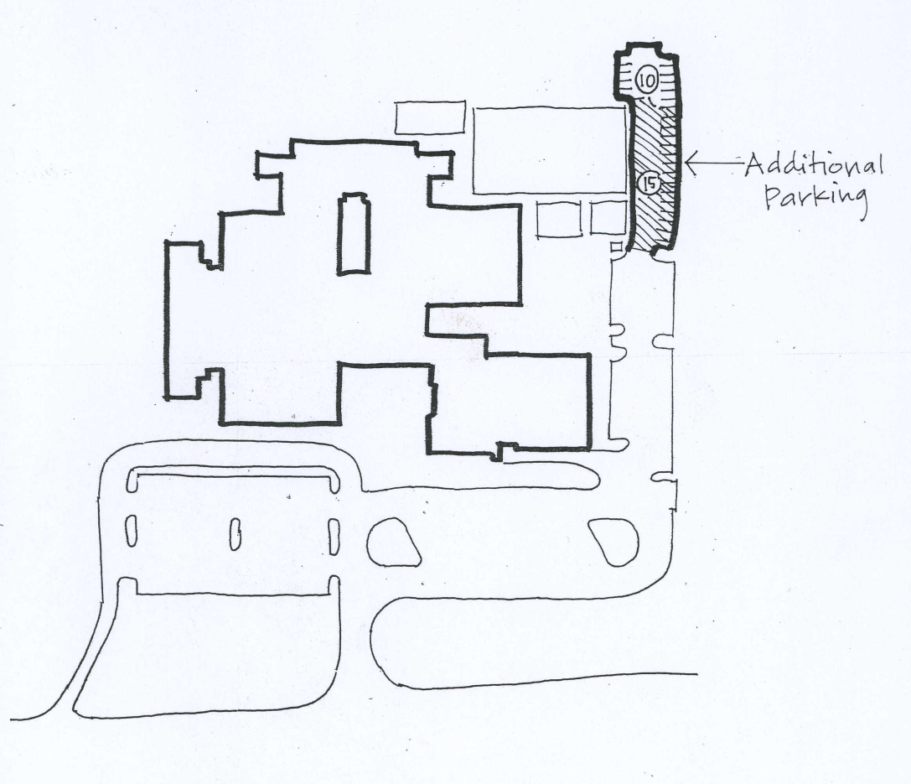
Cale Parking Lot Expansion
Capital Projects: LARGE ROOF HVAC SITE BUILDING

Slide 21
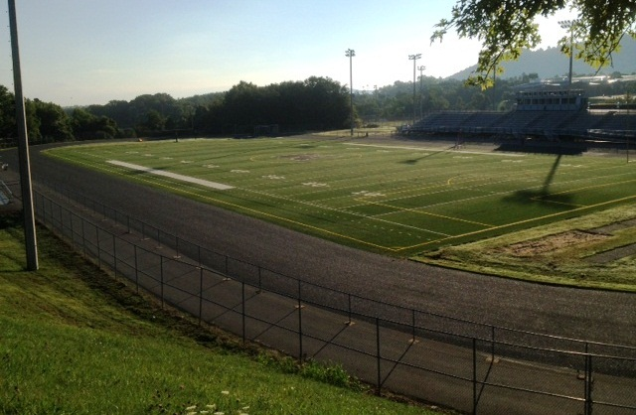
Monticello High School Track Resurfacing
Capital Projects: LARGE ROOF HVAC SITE BUILDING

Slide 22
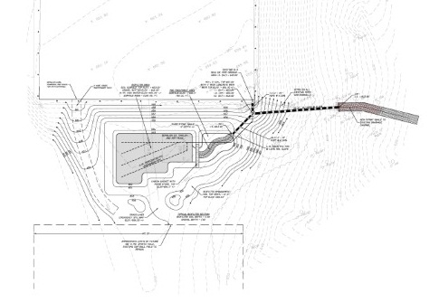
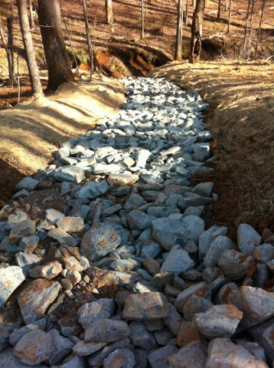
Western Stormwater Improvements
Capital Projects: LARGE ROOF HVAC SITE BUILDING

Slide 23
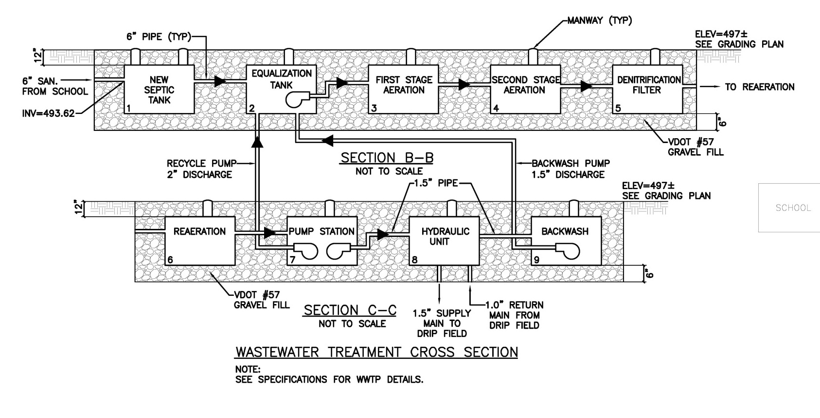
Yancey Septic Installation
Capital Projects: LARGE ROOF HVAC SITE BUILDING
Scheduled to break ground this month

Slide 24
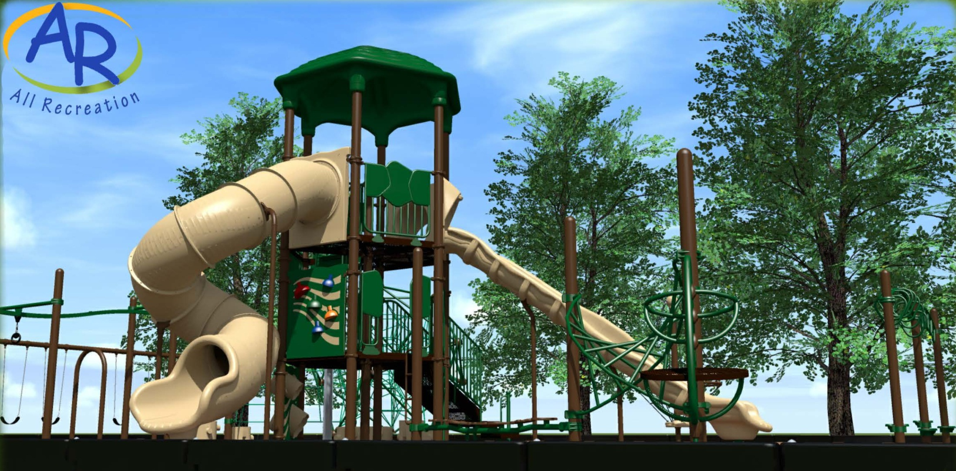
Playground Replacement
Capital Projects: LARGE ROOF HVAC SITE BUILDING

Slide 25
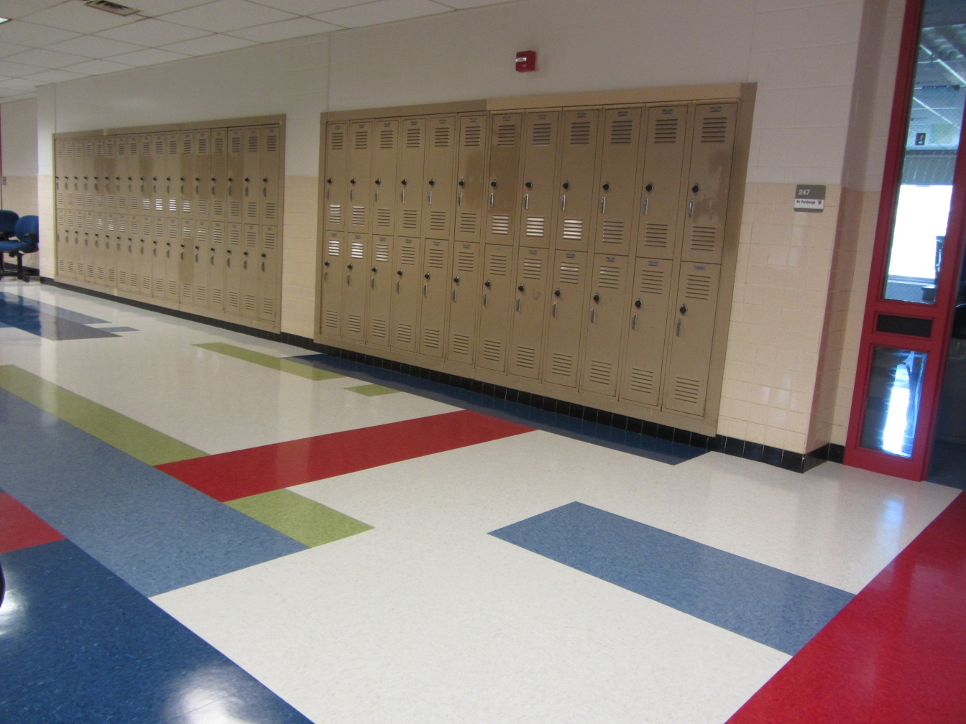
Flooring Replacement & Asbestos Removal
Capital Projects: LARGE ROOF HVAC SITE BUILDING
Work completed at:
Albemarle
Cale
Henley
Scottsville
Sutherland
Western Albemarle

Slide 26
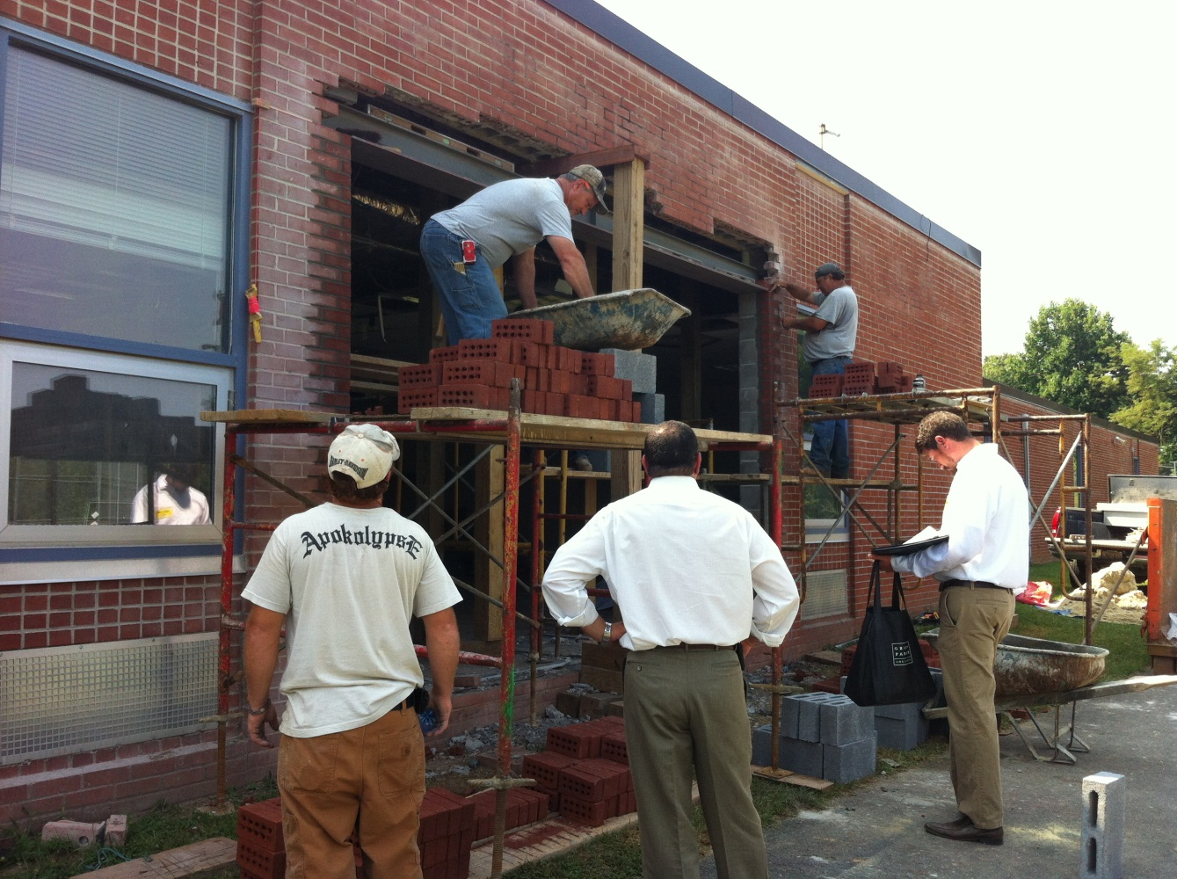
Contemporary Learning Spaces
Capital Projects: LARGE ROOF HVAC SITE BUILDING
Work completed at:
Albemarle: CTE Flex Space
Stone Robinson: Art Room/Maker Space
Sutherland: Science Suite

Slide 27
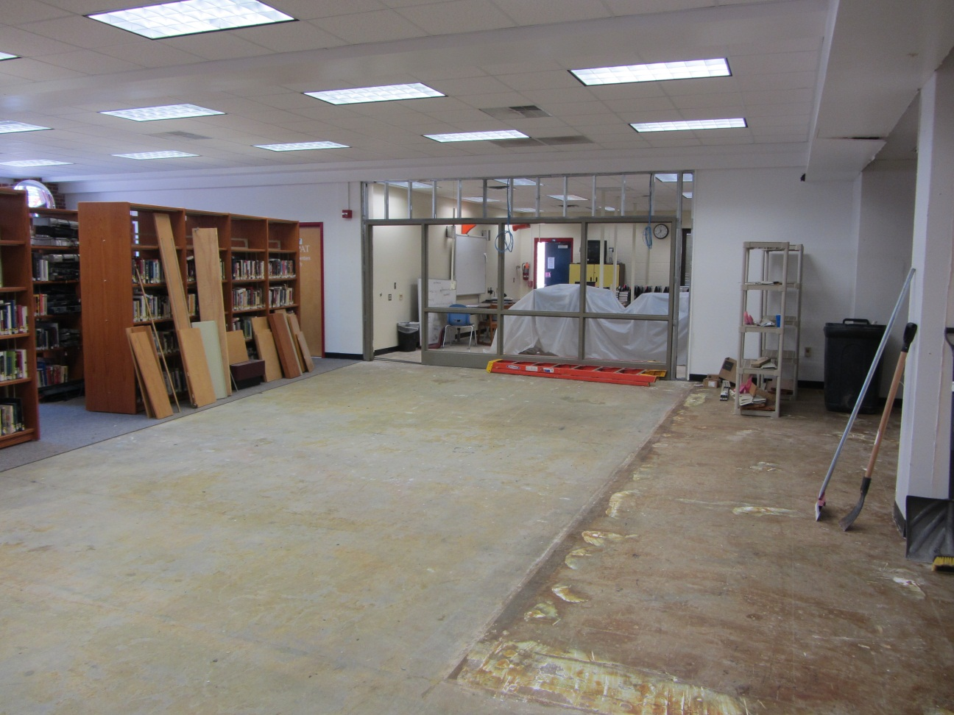
Media Center Upgrades
Capital Projects: LARGE ROOF HVAC SITE BUILDING
Work completed at:
Albemarle
Broadus Wood
Henley
Furniture purchased for:
Broadus Wood
Crozet
Henley
Western

Slide 28
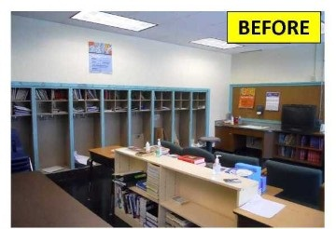
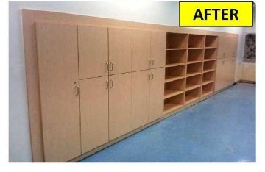
Murray High School Casework Updates
Capital Projects: LARGE ROOF HVAC SITE BUILDING

Slide 29
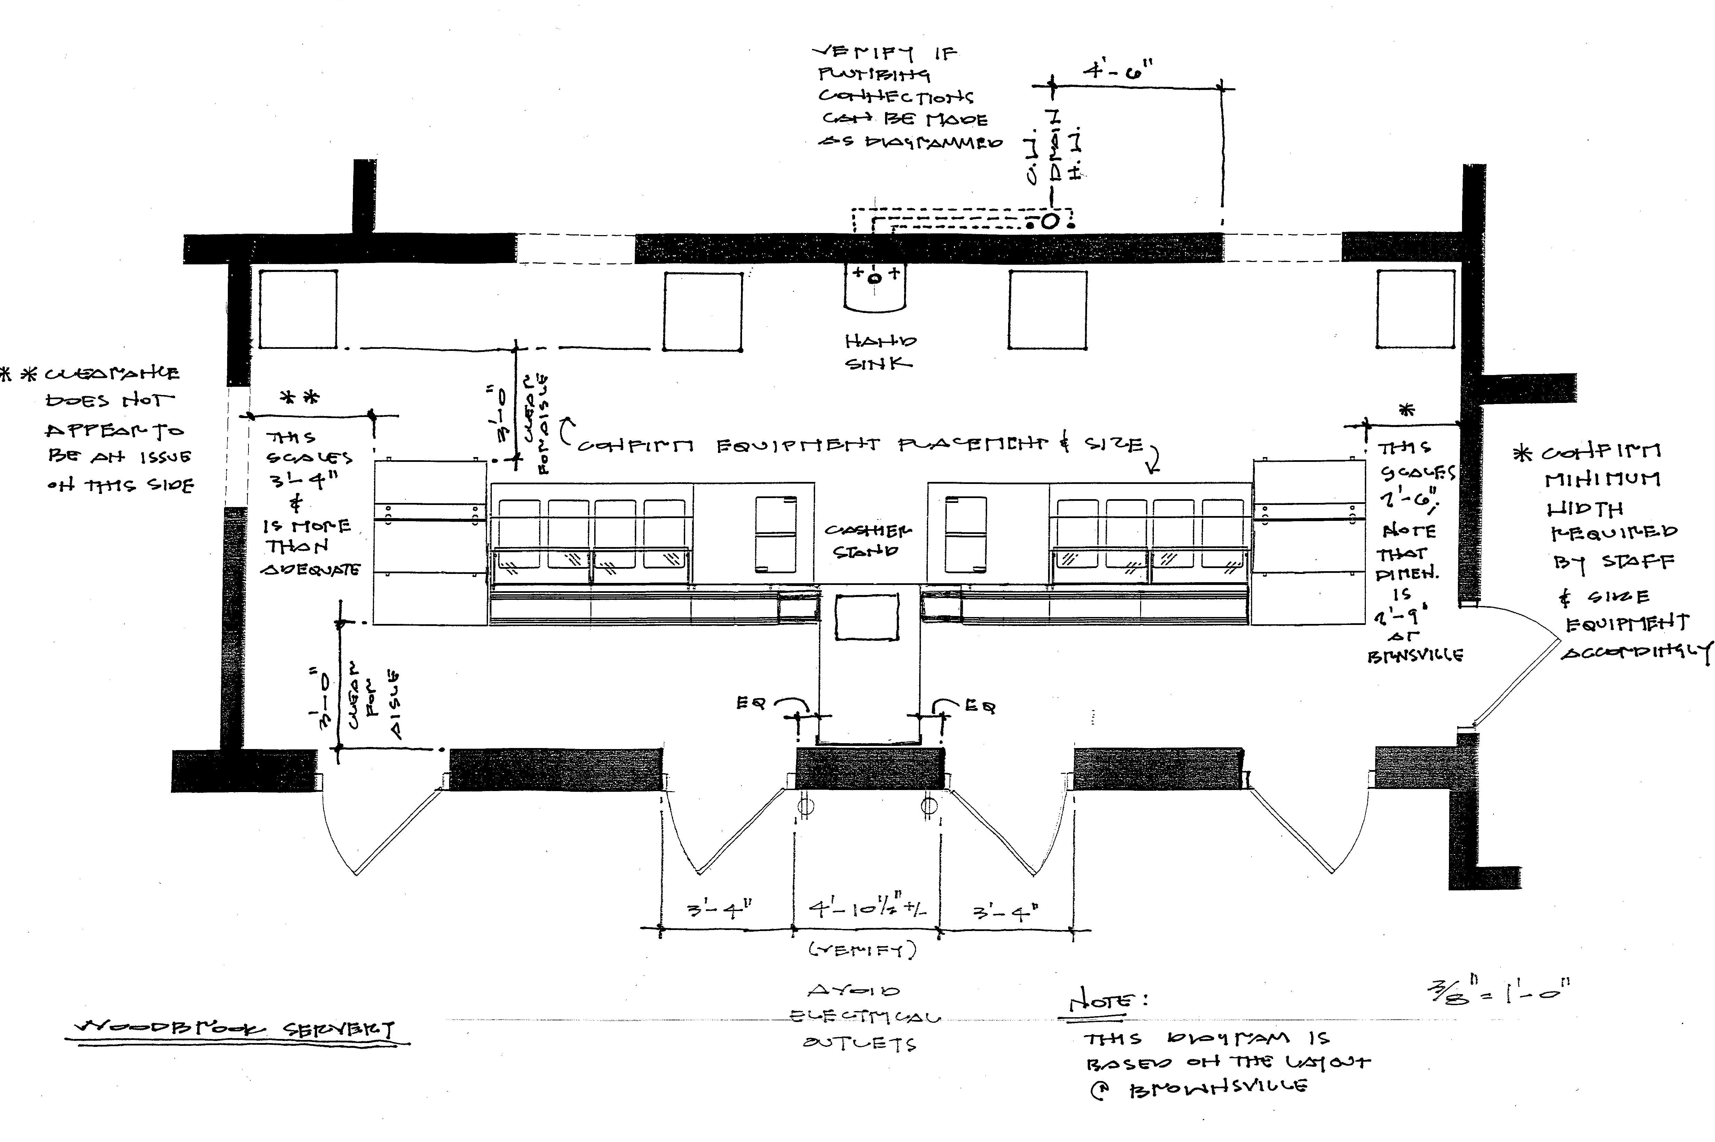
Woodbrook Serving Line Improvements
Capital Projects: LARGE ROOF HVAC SITE BUILDING

Slide 30
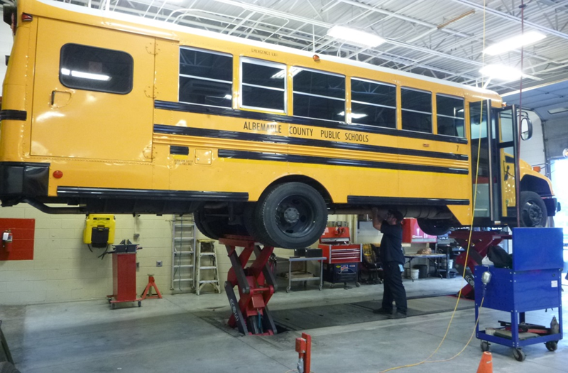
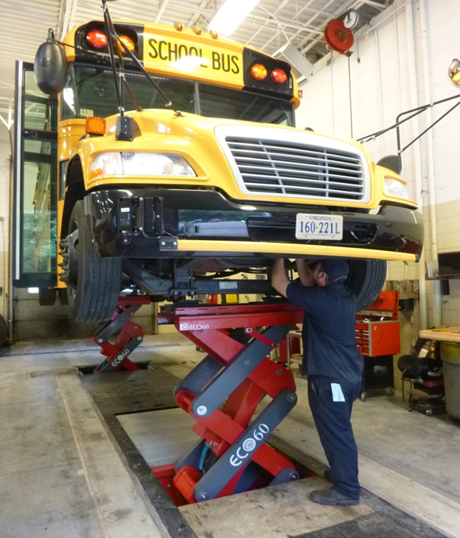
VMF Vehicular Lift Replacement
Capital Projects: LARGE ROOF HVAC SITE BUILDING

Slide 31
Transportation Department

Slide 32
Transportation Department
Supplied 43 buses and 4 cars for Summer School
Fully Staffed – completed training of 12 new drivers for the first day of school
Stop Arm Cameras – approved by BOS, RFP closed Aug 7, choosing vendor
Bus PM – completed annual preventative maintenance on fleet
Added third video camera to each bus (captures driver and stairwell)

Slide 33
Fiscal Services Department

Slide 34
Fiscal Services Department
Closed FY 2013/2014 Fiscal Year & opened FY 2014/2015 Fiscal Year
Completed activity fund audit
Examined budget document for improvements
Continued training of office associate staff in new building rental software/process
Continued deployment and training of staff for purchasing cards

Slide 35
Child Nutrition Department

Slide 36

Child Nutrition Department
Served meals at 8 summer school programs.
Provided food service catering to CFA
Created 2014-15 fall menu cycle
Updated all food bids, food production records, ordering guides, nutritional facts, and allergen list to reflect the menu cycle.
Fully staffed after hiring 2 cafeteria managers and 13 food service associate positions.
Training days in August included:
  New employee orientation
  Cafeteria manager meeting
  CNP team In-service Day
  DOE School Nutrition Manager workshop

